Slide 1
5
S
Benefits of 5S implementation
T.T.T
MOHAMAD NOR SYABIL BIN YAKOB

Slide 2
Learning Outcome
Upon completion of the session, participants will be able to implement basic 5S in everyday life and at work

Slide 3
ACTIVITY
Divide into 3 groups
1 person with marker and paper
1 person ready with timer
1 person to do the task

Slide 4
What is 5S ?

Slide 5
5S is a system for organizing spaces so work can be performed efficiently, effectively, and safely.
This system focuses on putting everything where it belongs and keeping the workplace organized, which makes it easier for people to do their jobs without wasting time or risking injury.
The 5S methodology originated in Japan and was first implemented by the Toyota Motor Corporation in the early and mid-20th century.
The methodology was developed as a way to make just in time (JIT) manufacturing possible.

Slide 6
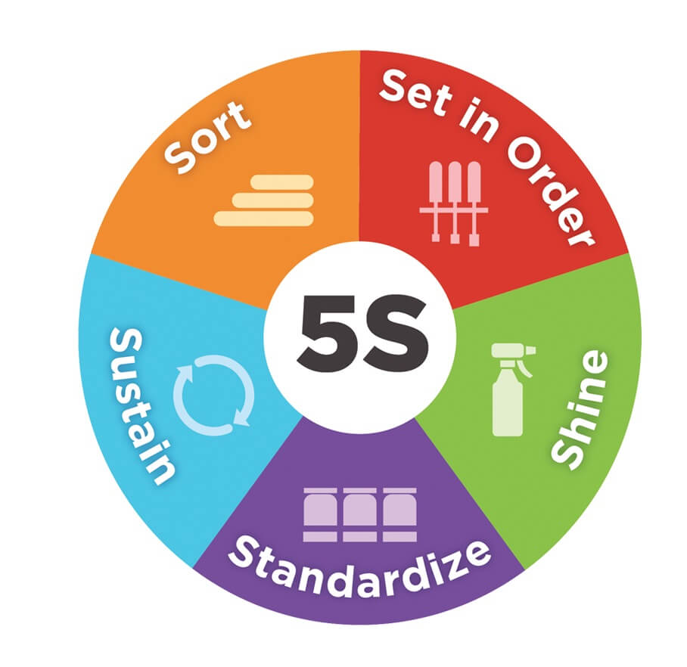
The term 5S comes from five Japanese words:
1. Seiri
2. Seiton
3. Seiso
4. Seiketsu
5. Shitsuke
In English, often translated to:
1. Sort
2. Set in Order
3. Shine
4. Standardize
5. Sustain
6. Safety
7. Spirit (Mental health)

Slide 7


Slide 8
What is SEIRI
SEIRI / SORT
Sort things.
Get rid of unwanted items
When you get rid of unwanted items
Item that you need will appear / easy to spot
When you have too many items unorganized, you will easily get confused of where or what they are
When you SEIRI / SORT, you will be at ease
Best to do in a fun way
I can’t remember what I put in here...wonder where is my black jacket

Slide 9
ACTIVITY
Divide into 3 groups
Discuss benefits of 5S (3 benefits)
Group 1 : Daily life
Group 2 : Manufacturing
Group 3 : Office

Slide 10
Occurrence of various wastes due to lack of 5s
Benefit of 5S
Waste occured due to lack of 5S
Effects of various waste eliminations
Sort
Cost reduction
Waste in finding things
Productivity improvement
Set
Transportation and movement Waste
Defect reduction
Waste of time waiting
Fault reduction
Shine
Wasted Inventory
Improved safety and security
Standardize
Waste of work itself
Increase motivation
Waste of defects and mistakes
Improve customer reputation
Sustain
Waste of asking around
Human resource development for the next generation

Slide 11
How to decide
Your items
Items you using
can’t use
don’t use
using
usually
maybe
frequent
occasionally
SEIRI these
SEIRI these

Slide 12
ACTIVITY
Back to activity 1 group
sort the items
1 person with pen and paper
1 person ready with timer
1 person to do the task

Slide 13
Learning Outcome
know how to categorize
able to sort your items

Slide 14
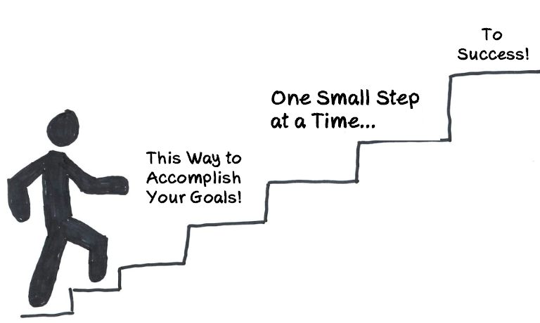
Thank you

